Slide 1
Meeting Week 5
Last week summary
Research Plan
Simulation - MIMO
Question 1
Question 2
Outline ToDo next week

Slide 2
Last week summary
Experiment design – Space filling
Simulation

Slide 3
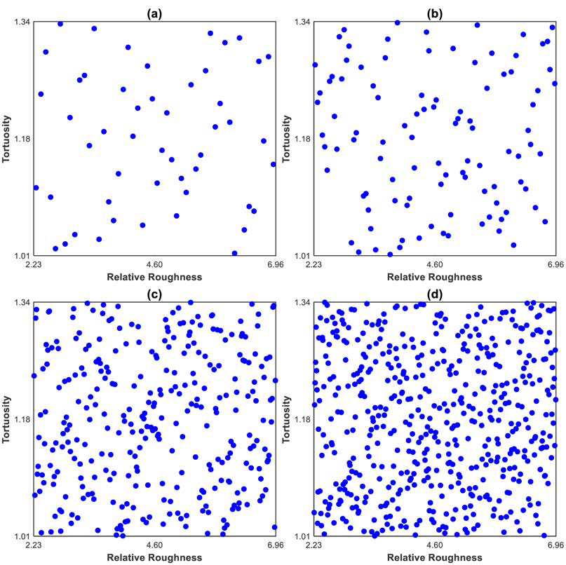
Experiment design - Latin Hyper Cube sampling
Latin Hyper Cube (LHC) sampling for space filling.
  Uniform distribution
Mentioned alternatives to LHC
  But not priority at the moment
Latin Hypercube Sampling with different numbers of realizations

Slide 4
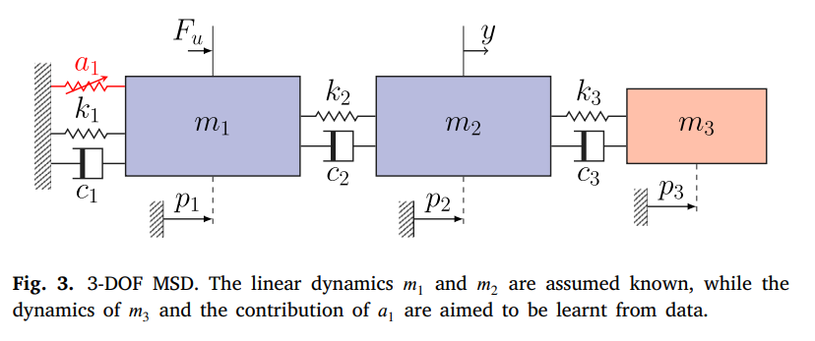
Simulation Jan - MSD system
Mass Spring Damper system: dynamics of the third (red) mass block and a nonlinear cubic spring (a1) attached to the known modeled system.
Baseline Model: The code assumes we only have an imperfect, simplified physical model: linear 2-DOF system that only takes the first two masses into account

Slide 5
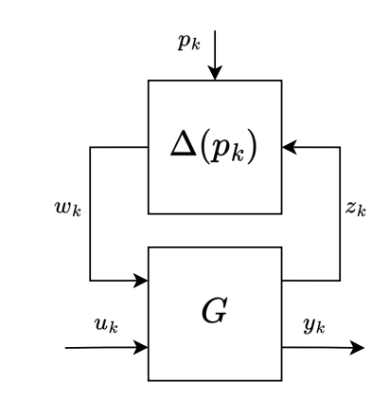
Simulation MIMO and LPV
Current code is adapted to SISO → Need to adapt structure to MIMO for dual-gantry
LPV-LFR
  Keep a baseline LTI part (fixed matrices), and add a structured block Δ(p(k)) in feedback/interconnection that injects the parameter-variation.
  Delta block (Δ(pk​)): difference between the baseline LTI model and the local linear model at the current operating point.
Notes:
Baseline LTI model: one fixed linear model (constant A,B,C,D) meant to approximate the system “on average” over a range of conditions. It does not change with operating point.
Local linear model at the current operating point: the linearization that best matches the system around the current state/inputs (i.e., around the current operating point). Its matrices effectively depend on where you are, so it can be written as A(p),B(p),C(p),D(p).
LPV models capture nonlinear behavior by letting the state-space matrices depend on a scheduling signal p(k). You can view this either as directly time-varying matrices A(p),B(p),C(p),D(p), or as an LTI baseline interconnected with a parameter-varying ‘delta’ block Δ(p(k)) that modifies the baseline dynamics as the operating point changes.

Slide 6
Research Plan
1. Background and already obtained results in the topic
2. Literature survey
3. Research questions
4. AI&ES relevance
5. Research methods
6. Expected outcomes of the project
7. Time planning phase 2

Slide 7
1. Background and already obtained results in the topic
Provide a short introduction to the topic of the project. What is the broad research area? What is the gap inknowledge of this topic that you are going to research and explain why it is important?

Slide 8
Motivation & Current Practice
Advanced Packaging Context:
  Hybrid bonding requires overlay accuracy
  Settling performance impacts yield + throughput
Standard Approach - Physics-Based Feedforward:
  Conceptual: F ≈ P⁻¹ (inverse modeling)
  MIMO: modal coordinates for dual-gantry coupling
Limitation:
  Systematic residual errors remain (friction, cogging)

Slide 9
Grey-Box Augmentation & Identifiability
Why Augment?
  Physics baseline: interpretable, extrapolates well
  Data-driven residuals: capture unmodeled effects
Existing Approaches:
  Basis functions: structured (friction models, Fourier series)
  Learning-based: flexible (neural networks, GPs)
Critical Problem:
  Physics parameters lose meaning, poor generalization
Safeguard:
  Orthogonality constraints preserve identifiability
Notes:
Basis functions (structured)
Idea: you choose a set of meaningful functions
Interpretable: coefficients map to known effects.
Data-efficient: strong prior structure → fewer parameters.
Easier to keep identifiable: you can often design them to not overlap too much with physics terms (or enforce orthogonality).
Main downsides
You must choose the right structure and inputs.
If the true residual isn’t well represented by your chosen basis, you’ll underfit.

Slide 10
Gap & This Project
Research Gap Existing dual-gantry control:
  Modal decoupling demonstrates significant error reduction
No frameworks for inverse augmentation preserving identifiability
This Research:
  Whether orthogonality-constrained augmentation improves settling while preserving identifiability
  Closed-loop identification feasibility for industrial systems
  Performance validation using settling error bounds

Slide 11
2. Literature survey
Relevant literature references of scientific articles and/or books that underlie the research proposal.
  Main articles I will use for research method
  Orthogonality papers
  Bas paper reference augmentation on industrial system
  Add more during method

Slide 12
3. Research questions
What are you going to research? Provide a clear specification of the main research question and possibly sub questions, including any hypotheses to be tested. Make the research questions measurable. It must be possible to ascertain whether the stated research questions have been achieved.

Slide 13
Main Research Question (MRQ)
How can we obtain an implementable (causal, stable) inverse/feedforward model for a coupled dual-gantry motion system from closed-loop data, and augment it with an orthogonality-constrained residual model such that the settling error bound improves while physical parameter meaning is preserved?
Notes:
Causal inverse model only depends on past inputs for model inversion

Slide 14
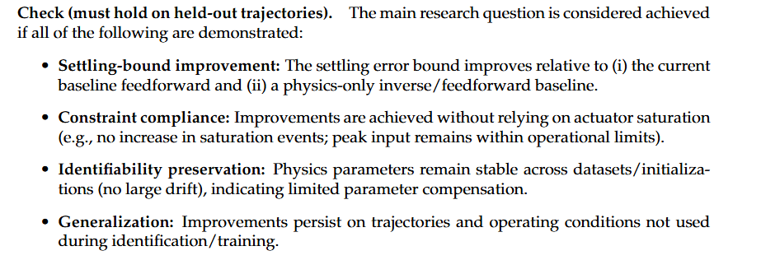
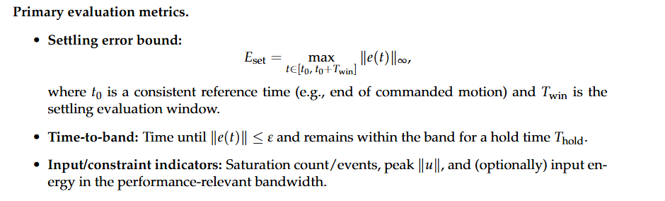
Notes:
Mathematical representation

Slide 15
RQ1: Implementable inverse/feedforward baseline from closed-loop data
RQ1: Which inverse/feedforward parameterization yields an implementable and effective baseline for settling-bound improvement using closed-loop operational data?
(Time-to-band: settling performance metric measures how long it takes for positioning error to enter and remain within a specified tolerance band.)
Measurable outcome. Demonstrate a stable, causal implementation and quantify settling-bound and time-to-band performance relative to the current baseline feed forward on held-out trajectories.
Notes:
Time-to-band is a specific settling performance metric that measures how long it takes for positioning error to enter and remain within a specified tolerance band.

Slide 16
RQ2: Orthogonality as anti-compensation mechanism
RQ2: Does enforcing orthogonality between physics and residual model directions reduce parameter compensation and improve out-of-sample performance compared to unconstrained augmentation?
(Out-of-sample: performance on new data the model hasn't seen during training (validation/test trajectories))
Notes:
Out-of-sample performance on new data the model hasn't seen during training (validation/test trajectories). This is the critical test of whether orthogonality actually works.

Slide 17
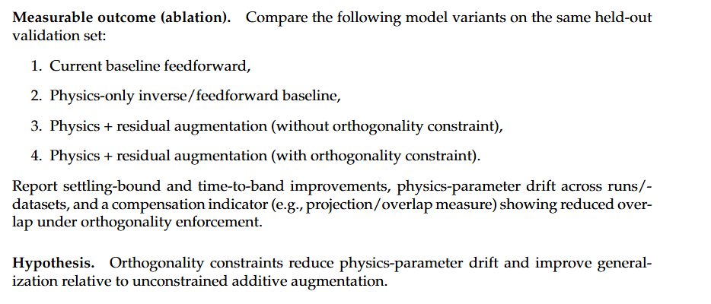

Slide 18
4. AI&ES relevance
Explain why your project fits the Artificial Intelligence & Engineering Systems domain.

Slide 19
This project fits the AI &ES domain because it combines:
  AI / data-driven learning: learning a structured residual model from measured data to capture repeatable dynamics that a first-principles model misses.
  Engineering systems: embedding the learned residual in a physics-based inverse/feedforward model for a real dual-gantry system, accounting for coupling, stability, and actuator limits.

Slide 20
Simulation - MIMO
Asked other PhD student for adapted MIMO code
Compared it to the code of Jan
To change the structure to MIMO have to change two lines of code
Important Encoder function:
  Neural network that estimates the initial latent state X0 of the state‑space model from a short history of measured data.
  Enables us to train a state‑space model from only input/output data (u,y)

Slide 21
Fix ny so the encoder input includes all output channels (MIMO)
  Before (public repo): modified_encoder_net.__init__ hardcoded
  self.ny = tuple() → treats output-history size as 0
  Easy way to not scale the encoder with the number of outputs (SISO only shortcut)
Effect: the network input size becomes nb*nu + na*ny instead of nb*nu + 0, so it matches the flattened ypast for ny>1
Optional: Instead of using custom encoder switch to imported one from DeepSI library (adapted for MIMO)

Slide 22
na is the number of past time steps you feed in, and ny is how many outputs you have at each time step.
For SISO, ny=1, so na*ny = na.
  Each past time step contributes 1 output value. With na time steps, you have na x 1 = na output numbers.
For MIMO, ny>1, so na*ny grows.
  Each past time step contributes multiple output values. With na time steps, you have na x ny output numbers.

Slide 23
Question 1
Should the vibration system be taken into account for closed-loop system identification?
  Or stepwise, first leave out vibration system

Slide 24
Question 2
Are there specific motion profiles available for the dual-gantry system for the hybrid bonding?
  To capture data relevant for improving settling error bound.
  Is the starting position or region where the gantry starts always the same?
    Could I drastically reduce the region by only considering this starting position/region?

Slide 25
Outline next week
Finish Research plan
  Main focus on Research methods and planning phase 2

